Slide 1
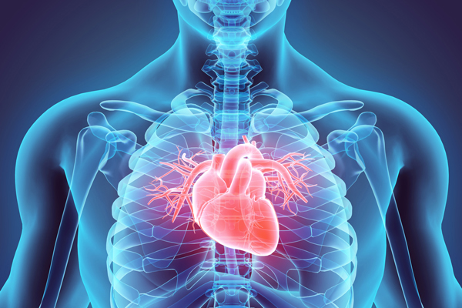
HEART DISEASE PREDICTION USING MACHINE LEARNING
NAME : NITHIN VARMA EMAIL: nchinta2@kent.edu

Slide 2

THE PROBLEM
To know which model accuracy is perfect for the dataset and predict the heart disease
The objective is to determine whether the patient is suffering with heart disease or not . I used classification techniques from machine learning to fit a function that can predict the discrete class of new input to accomplish this.
To determine the heart disease before hand so that it can be predicted and the needful can be done with the patient

Slide 3
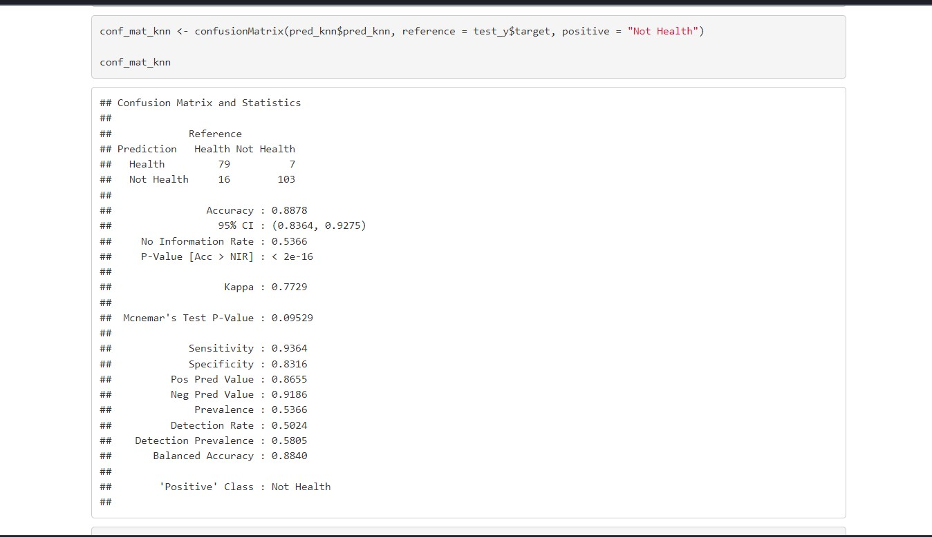
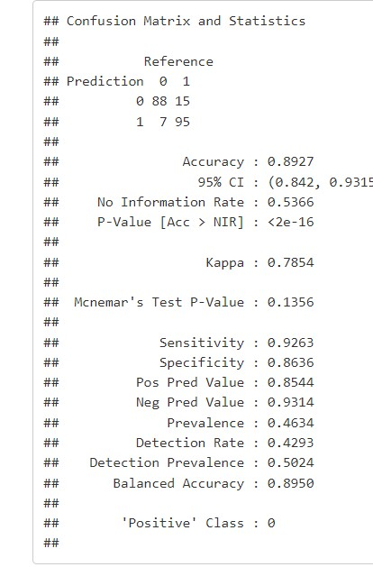
The Approach I used classification techniques , Decision tree model and Knn model so that we will know which model is more accurate with its prediction and which is best to use Decision tree knn model

Slide 4
The Results
.
ue.
Decision tree model (Accuracy = 0.8927)
Knn model(Accuracy = 0.8878)
By the Before diagram we can say that Decision tree model is more accurate than the Knn model
If a doctor want to give a better treatment diagnosed with heart disease , they will use a method with better Accuracy value so here decision tree has the better accuracy value so this model is used for predicting it in this particular dataset

